Slide 1
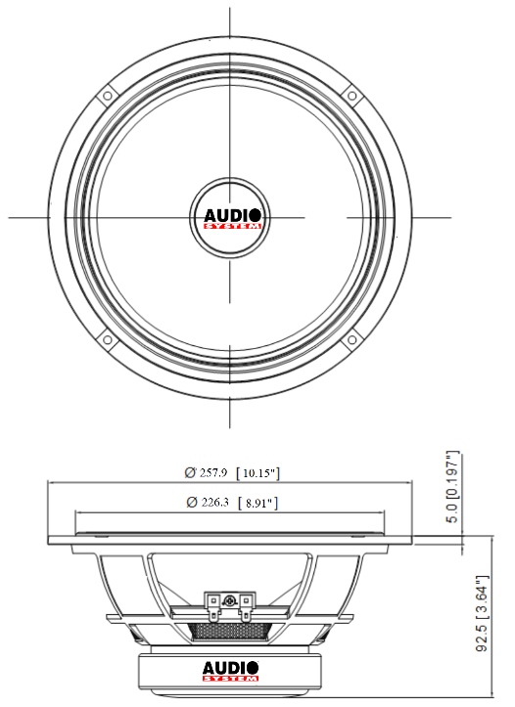
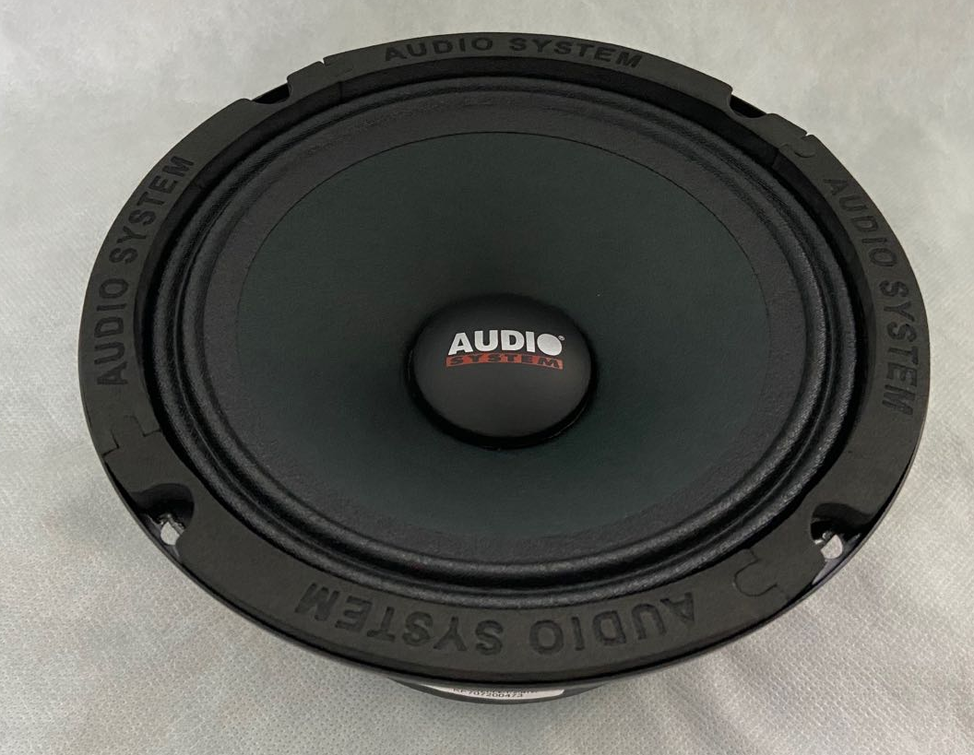
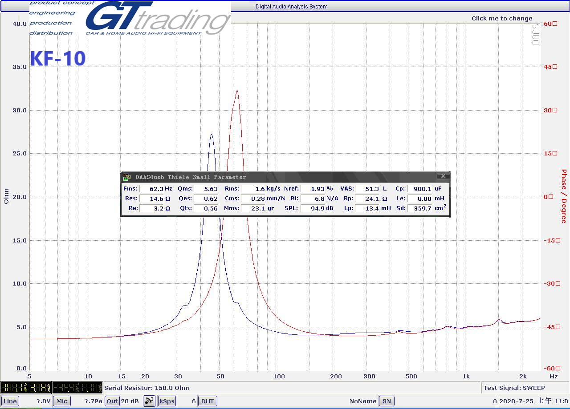
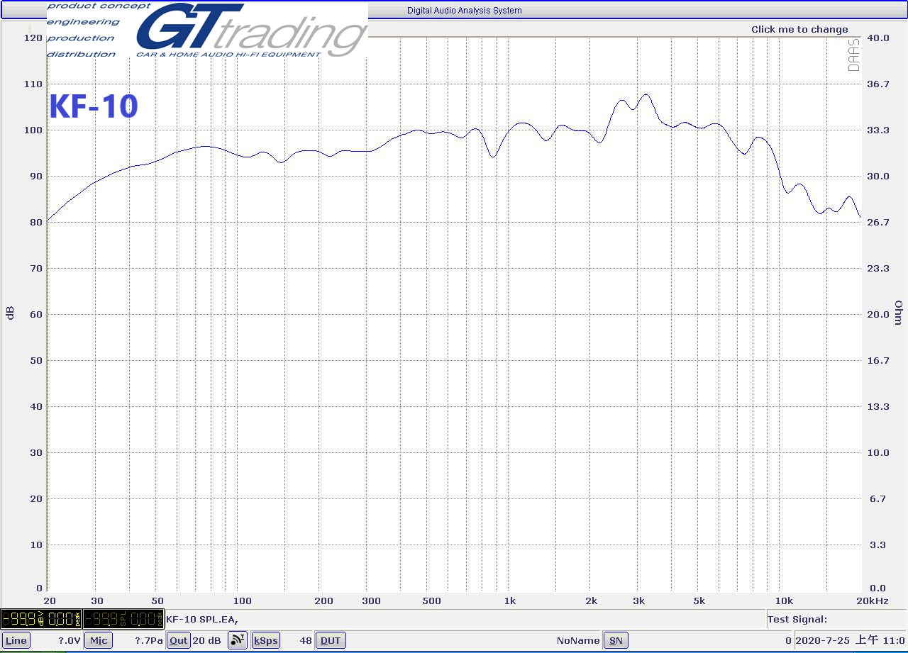
SPECIFICATIONS | KF-10
RMS Power (W) | 200
MAX Power (W) | 400
Fo (Hz) | 62
Nominal Impedance (Ω) | 4
Sensitivity @1w/1m (dB) | 96±2
Frequency Range | 60Hz 10KHz
Magnet | 45 Oz
Voice Coil | 1.5"
Cone | PAPER CONE
Mounting Depth (mm) | 92
Mounting Diameter (mm) | 232

